Slide 1
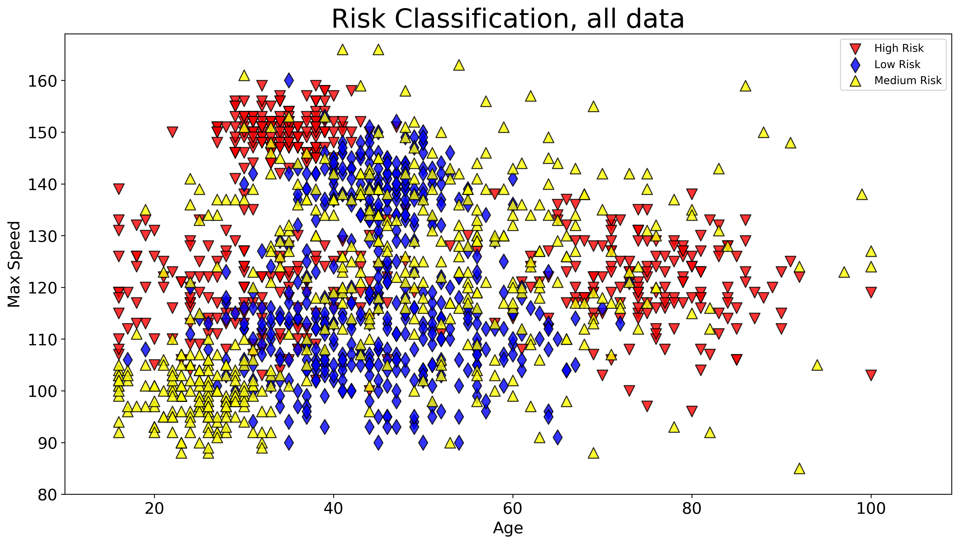
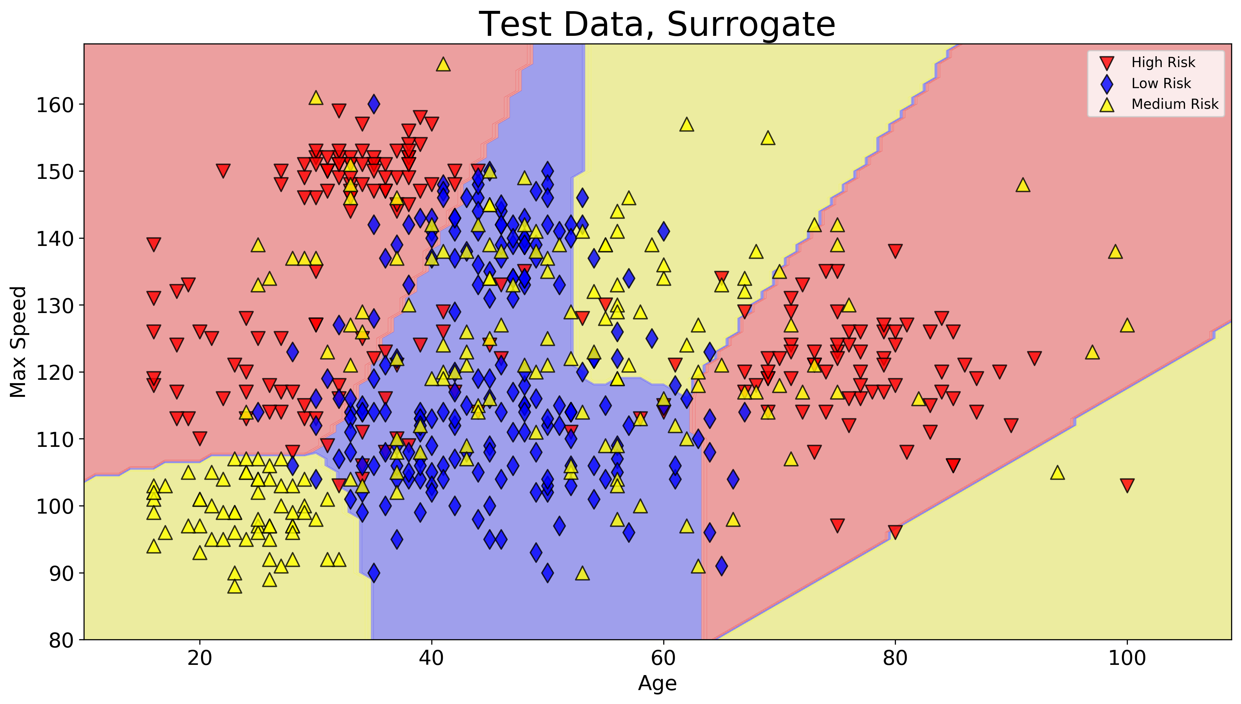
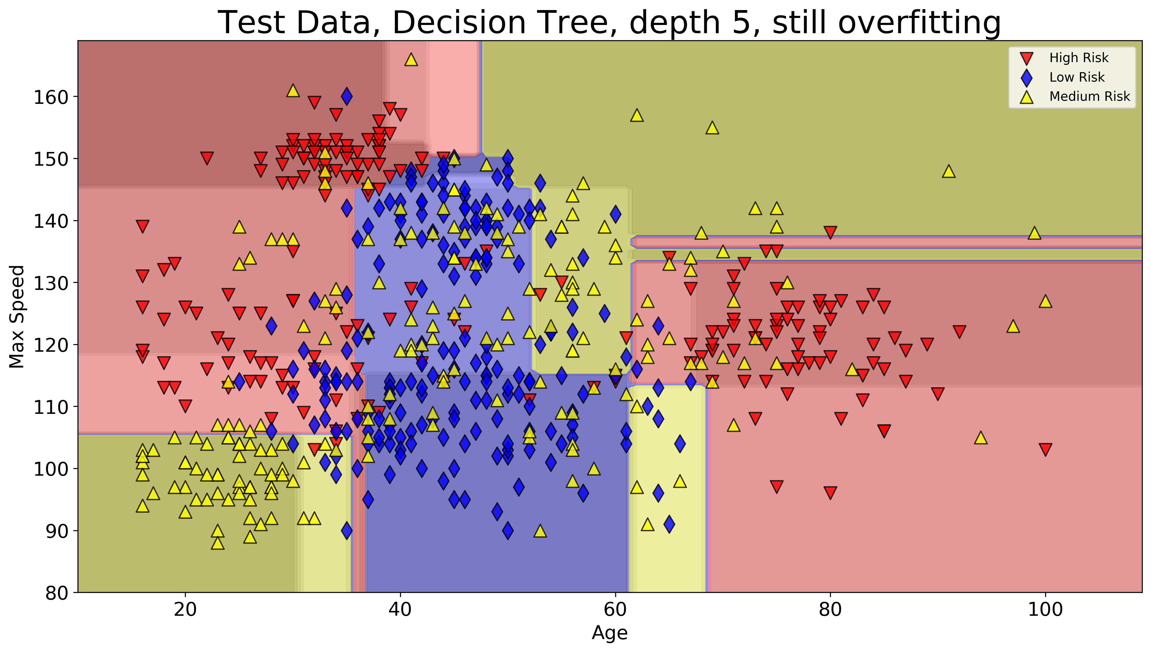
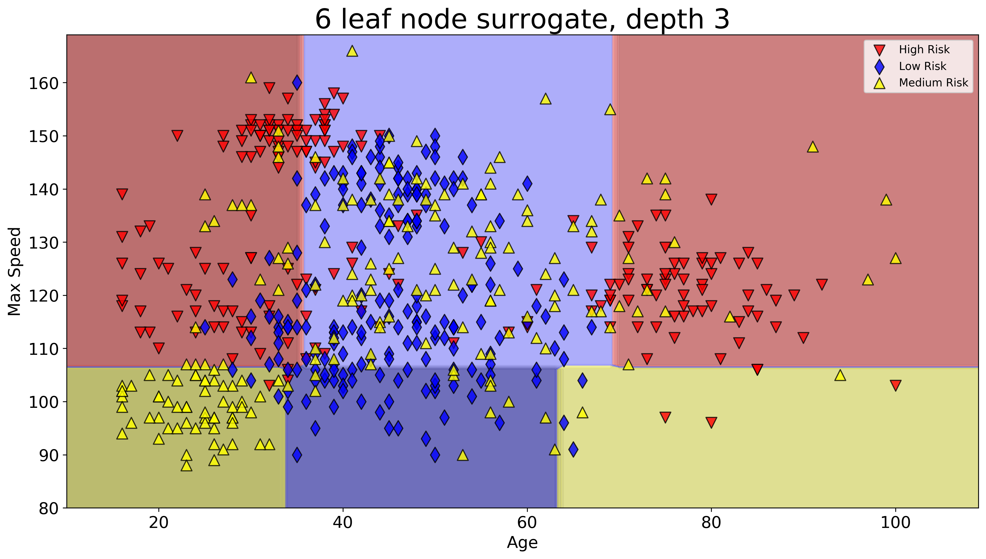
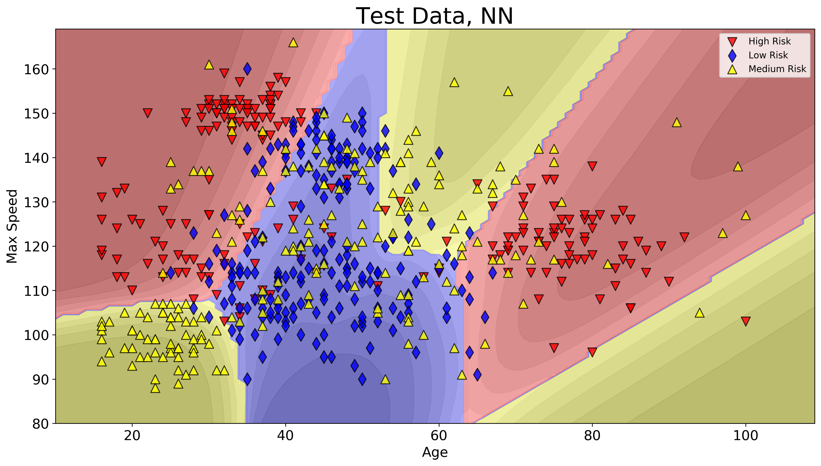
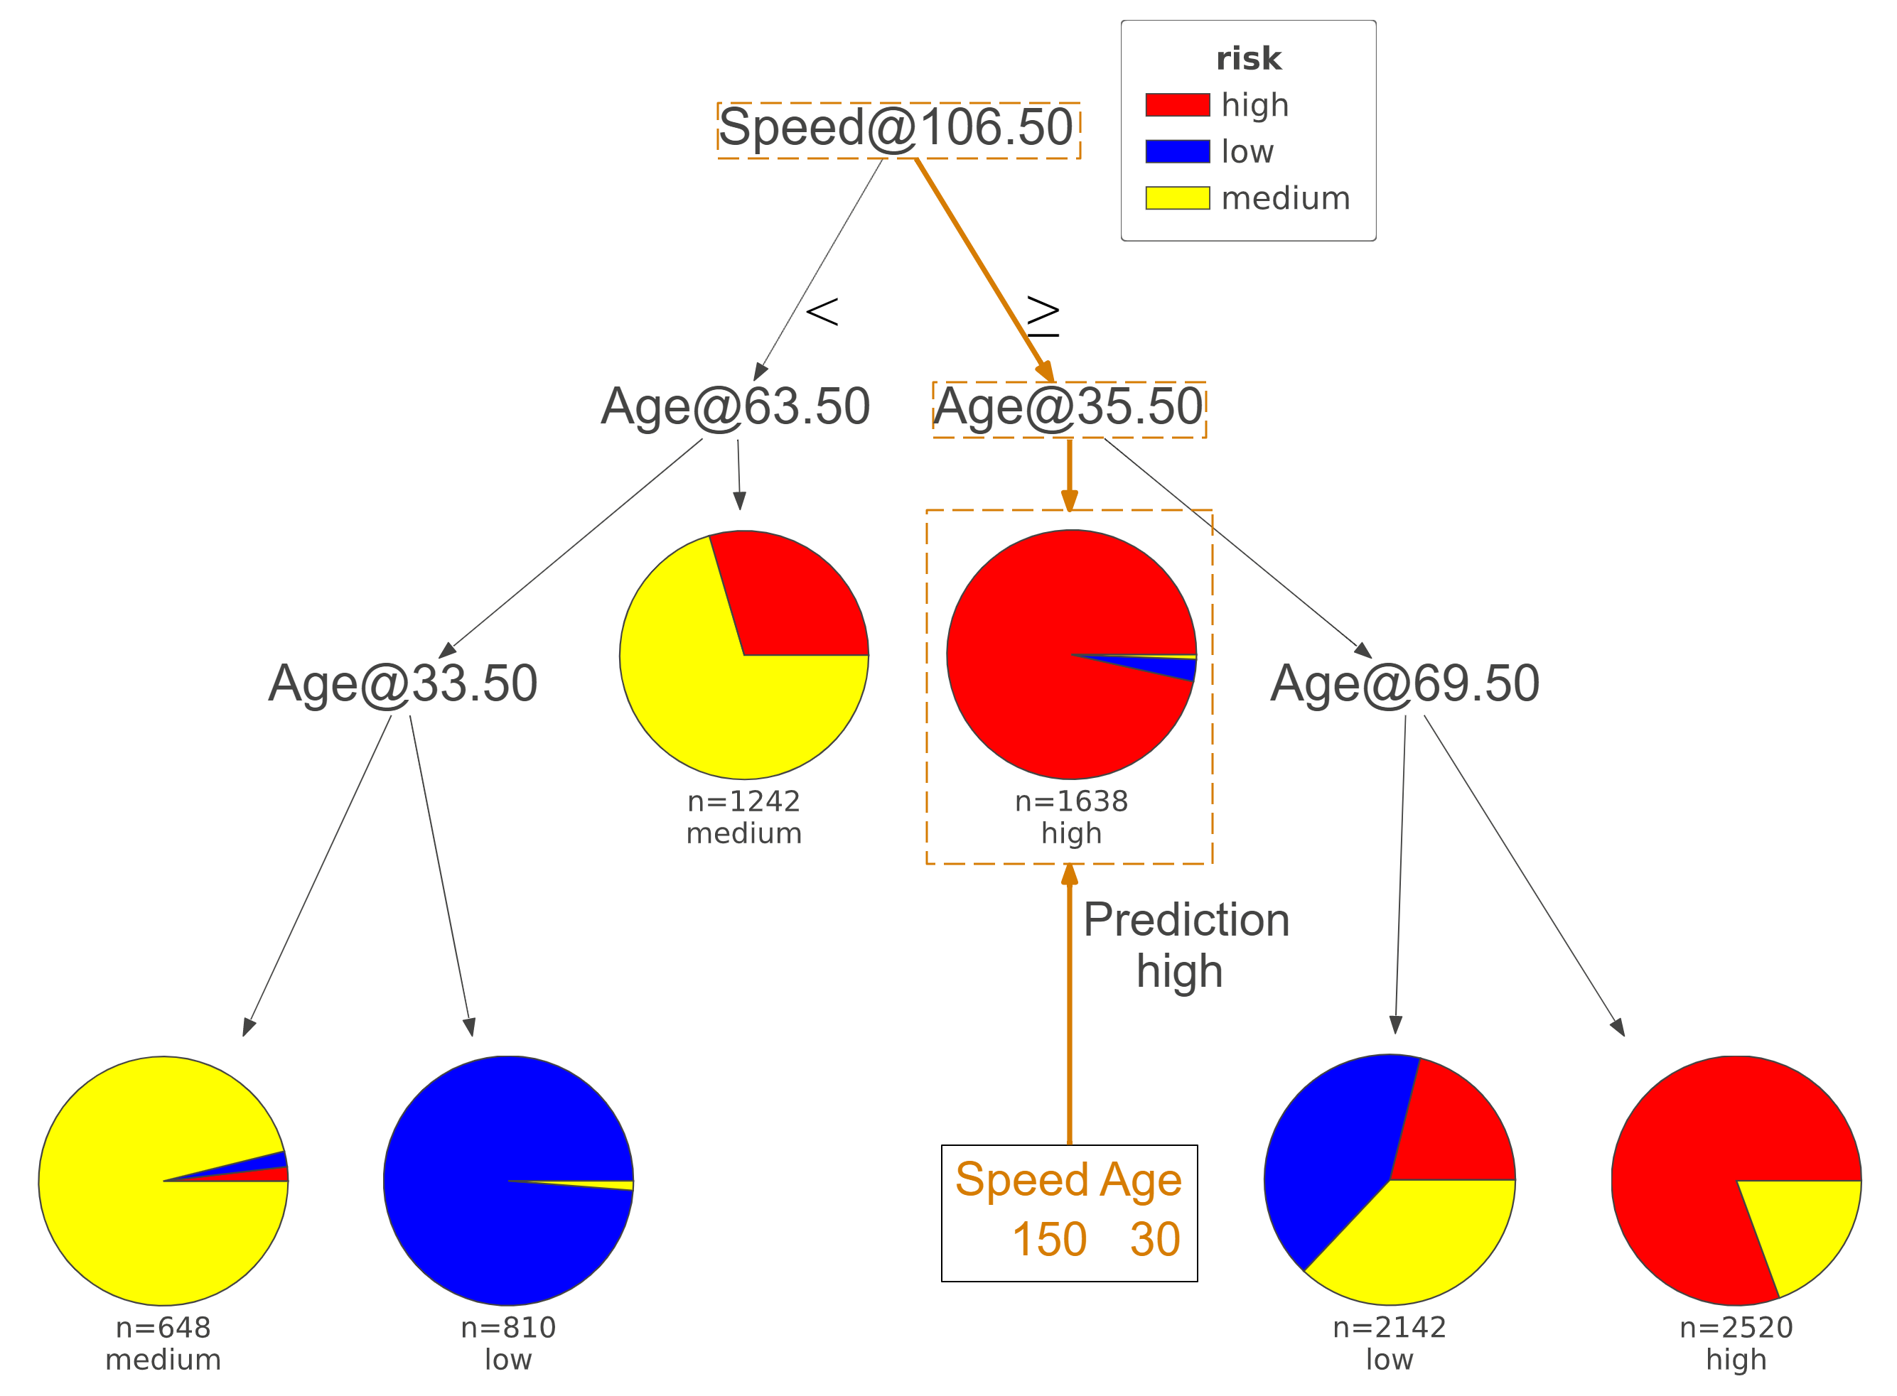
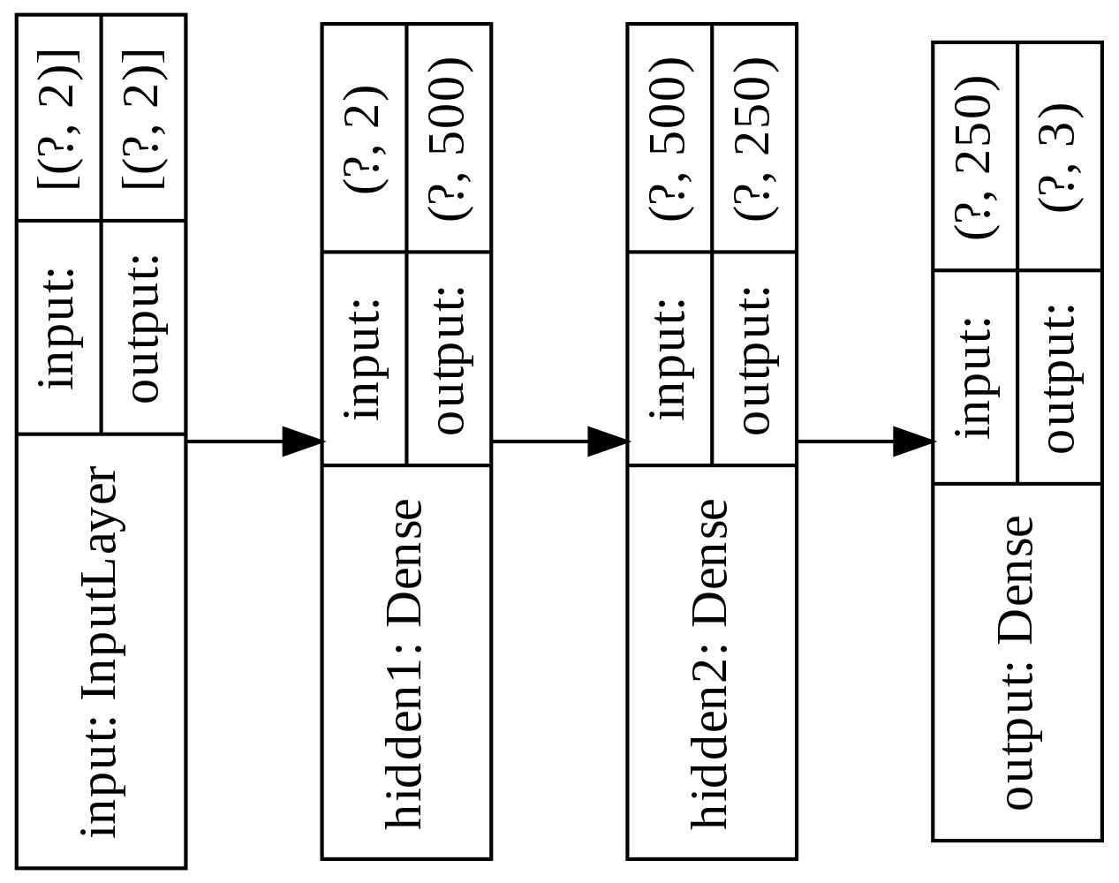
Scaling Down – Squaring Deep Neural Networks for interpretability and lightweight deployment Oliver Zeigermann, http://scaledml.org/2020/
Use Case - Risk Prediction
We want to score the risk of drivers based on their age and max speed of their cars
Deep Neural Networks perform well
l1 regularization gives good accuracy (70%) without any overfitting, but also 130k parameters make this a block box
Decision Trees can be tuned for
accuracy: same score as teacher, but depth of 12
interpretability: 62%, 6 leaf nodes, depth of 3
Sample prediction path (kudos to dtreeviz)
Decision Trees offer explainability
the right to explanation is well established by the GDPR and United States' Credit score
shallow decision trees allow for at least a basic level understanding,
but tend to overfit even when regularized
can be used to generate readable code
Best of both worlds – use DNN as a teacher for Student Decision Trees
high capacity deep neural network is trained and regularized like shown in left column
used to predict a dense set of data over complete range of domain
this data, not original data, is used to train decision tree
by restricting depth of student decision tree you can balance between accuracy and interpretability
In both cases no overfitting is expected
Notebook: http://bit.ly/scaling-down-2020

